Slide 1


Mentor Leadership Programme
Day 3: Practising Mentoring
27th January 2021
WWW.YORKSJ.AC.UK

Slide 2
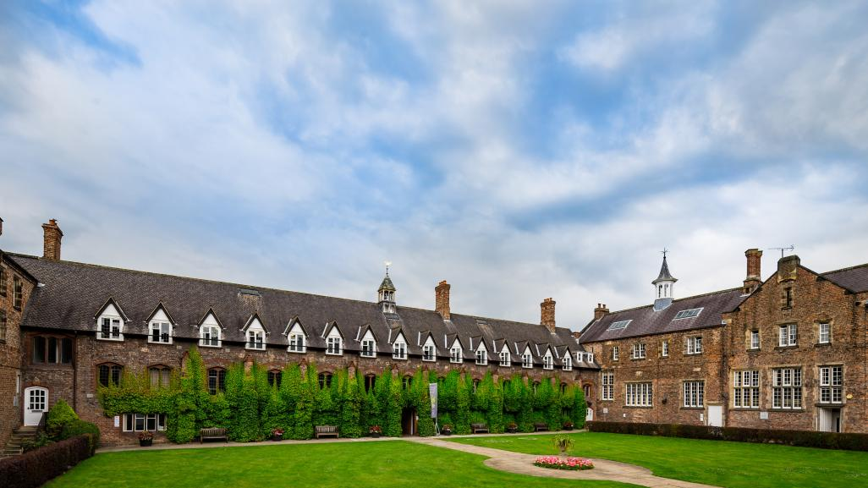

Welcome back (virtually)!
www.yorksj.ac.uk

Slide 3


Housekeeping on Zoom
Use mute during keynotes, optional camera
Stay logged in for the day but turn off video and microphone during breaks
Keynotes are recorded
Use the Chat function if you’ve got any questions during keynotes
You’ll automatically be sent to breakout rooms and brought back
www.yorksj.ac.uk

Slide 4

Mentor Leadership Programme
Day 1: Yourself as a mentor
Identify the coaching and mentoring culture within your own setting
Be aware of your own strengths and areas for development in the role of mentor
Challenge what is understood to be coaching and mentoring
Set targets for personal and professional development
www.yorksj.ac.uk

Slide 5
Mentor Leadership Programme
Day 2: Mobilising mentor strategies
Review your own practice and development as a mentor
Identify the differences between coaching and mentoring
Understand the limitations of one’s own influences, skills and experience
Develop own techniques and skills in coaching and mentoring
Set targets for own personal and professional development, developing reflexivity
www.yorksj.ac.uk

Slide 6


Feedback from Day 2
Everything was great
It was really worthwhile and I got to meet colleagues from different schools and authorities
Really enjoyed the sessions and I learnt a lot
The presenters were excellent, there was a good selection
Would have liked to be in a group with others in similar roles
Would have liked role play or scenarios to work through
Not enough chocolate brownies
Nowhere to sit for lunch
www.yorksj.ac.uk

Slide 7

Day 3: Practising mentoring
Outcomes
Reflect upon your own practice and development as a mentor and coach
Utilise case studies of your practice to develop reflexivity
Apply skills and techniques alongside coaches and mentors
Review and set targets for personal and professional development
www.yorksj.ac.uk

Slide 8
Agenda
9.30am Keynote Guest Speaker: Kirk Kinnell
10.30am Questions
10.45am Reflective break
11.00am Guest Speaker: Sarah Clarke: a model of coaching
11.30am Practising coaching (breakout rooms)
12.30pm Reflective Lunch
1.30pm Guest Speaker: David Britten: a model of coaching
2.00pm Practising coaching (breakout rooms)
3.00pm Reflective break
3.15pm Plenary
3.45pm Close
www.yorksj.ac.uk

Slide 9
www.yorksj.ac.uk

Slide 10
Plenary
Reflect upon your own practice and development as a mentor and coach
Utilise case studies of your practice to develop reflexivity
Apply skills and techniques alongside coaches and mentors
Review and set targets for personal and professional development
www.yorksj.ac.uk

Slide 11
Aims of the Programme
To reconceptualise the process of mentoring and acknowledge the complexities arising within the relationship between mentor and mentee
To place the self as mentor in a reflexive capacity so that the mentoring process is both effective and flexible
To create a network of established mentors from a range of schools and settings in order to share and learn from practice
www.yorksj.ac.uk

Slide 12
Evaluation
Tell us what you think: use the link in the delegate pack (p 13)
https://www.surveymonkey.co.uk/r/FT92TBF
www.yorksj.ac.uk

Slide 13

Celebration
  Certification:
  You will receive a Lead Mentor Certificate in the next couple of weeks via your email address
  Your headteacher or CEO will receive a hard copy through the post with a letter of recognition
  Please ensure you have left your contact details, name and school address via the feedback form on page 13 of the delegate pack or click on this link:
  https://www.surveymonkey.co.uk/r/FT92TBF
This Photo by Unknown Author is licensed under CC BY

Slide 14
Next steps
Your thoughts?
To be confirmed:
Expert/Master Mentor Programme
3 twilight sessions over a 12 month timescale
Development of your coaching skills
Portfolio of practice and reflections
Evidence of your wider impact within your school/ cluster/Trust and contribution to the Lead Mentor Programme
Expressions of interest:
j.carpenter@yorksj.c.uk
www.yorksj.ac.uk

Slide 15
Thank you!
www.yorksj.ac.uk

Slide 16
www.yorksj.ac.uk

